Slide 1
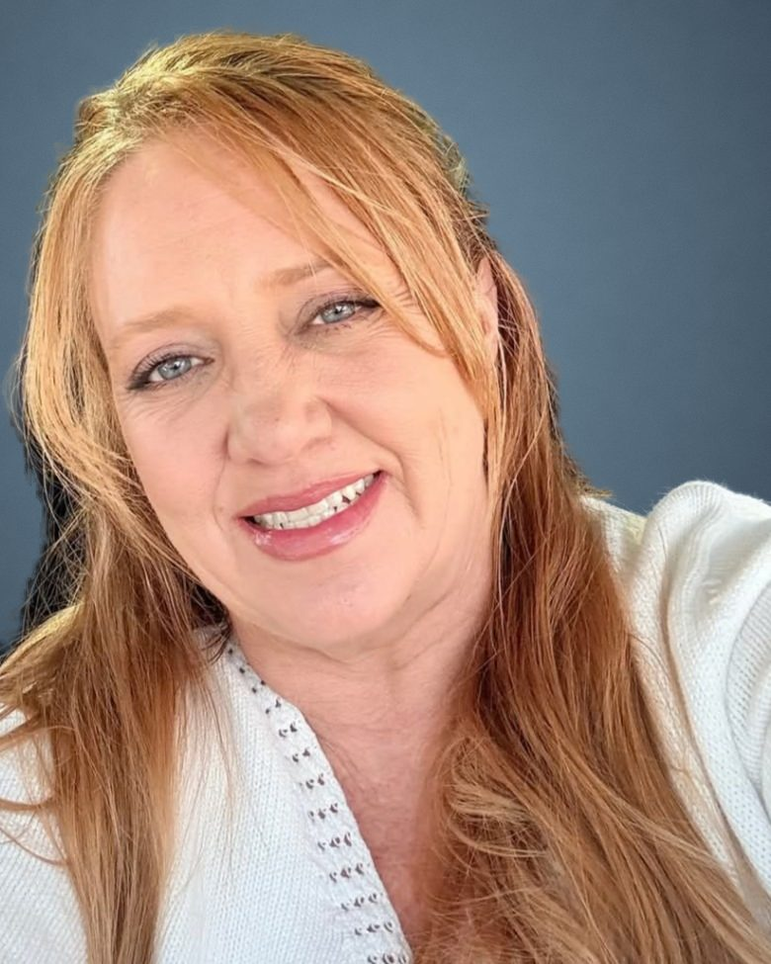
A FREE, NO-PRESSURE WORKSHOP
Protect what matters. Make your wishes clear.
A plain-English guide to estate planning, retirement and Medicare, for you and the people you love.
Wynn Collins
Legacy Estate and Insurance
Notes:
[About 1 min] Welcome everyone as they settle. Introduce yourself by first name. Say: 'Over the next 40 minutes I'll keep it practical, a little fun, and you'll leave with a checklist you can actually use.'

Slide 2
BEFORE WE BEGIN
Today's promise to you
This isn't about expecting the worst. It's about making things easier for the people you love.
Clear information
Plain words, real examples, no legal jargon.
No scare tactics
Nobody needs to be frightened into planning.
No pressure
You leave with ideas and a checklist, not a sales pitch.
Notes:
[About 1 min] Set the tone. Tell them there will be a few quick games and show-of-hands moments, and that nobody will be asked to share anything private.

Slide 3
WHO I AM
Hi, I'm Wynn Collins.
Estate planner and insurance producer, and founder of Legacy Estate and Insurance in Knoxville, Tennessee.
30 years
helping families with trusts, retirement income and Medicare
All 50 states
I work with families wherever they live
A real person
When you call, you talk to me, not a call center
Notes:
[About 1.5 min] Keep this short and warm. Share one sentence about why you do this work (a family you helped, or your own experience). Make the point that people reach you directly.

Slide 4
QUICK SHOW OF HANDS
Where are you today?
Raise your hand for each one. No wrong answers, and no one will ask for details.
I have a will
I have a living trust
I've named someone to make medical decisions for me
I've checked my beneficiaries in the last 3 years
My family knows where my papers are
Notes:
[About 1.5 min] Read each line and pause for hands. React kindly: 'Look at that, about half the room.' This is the room getting comfortable, not a test. On the website, visitors tap their answers.

Slide 5
YOU'RE NOT ALONE
Most Americans haven't finished their plan.
24%
of U.S. adults have a will
13%
have a living trust
Source: Caring.com and YouGov survey of 2,500+ U.S. adults, January 2025
Notes:
[About 1 min] Normalize it: 'If you don't have these yet, you're in the majority. The good news is that it's one of the most fixable problems in life.'

Slide 6
A MOMENT TO REFLECT
Imagine your family had to step in tomorrow.
What would you most want them to know first?
1 Who should be called?
2 Where are the important papers?
3 Who understands your wishes?
4 What do you want protected?
Notes:
[About 2 min] Ask everyone to pick the one question their family would struggle with most. Give them 20 seconds of quiet. Then: 'Hold on to that one. By the end today you'll know how to answer it.'

Slide 7
PART 1
The big picture
Notes:
[About 0.5 min] Transition: 'Let's start with what estate planning actually covers. It's more than a will.'

Slide 8
THREE LANES
Estate planning covers more than your things.
Your property
Who receives your home, savings and belongings, and how.
Your care
Who can speak with doctors and make health decisions if you can't.
Your decisions
Who can pay bills and handle money matters if you need help.
Notes:
[About 1.5 min] Use the image of three lanes on a highway. Most people only think about lane one. Lanes two and three matter while you're alive.

Slide 9
WITHOUT A PLAN
If you don't decide, the state decides for you.
State law picks your heirs
based on how closely relatives are related, not on your wishes.
Probate court
A public court process. In Tennessee, creditors get four months from the published notice, so an estate can't close sooner.
Your family waits
Accounts can be frozen and decisions delayed while the court works.
Notes:
[About 2 min] Keep it calm and factual. Rules vary by state; say so. The point is that planning lets them choose, instead of the default rules choosing for them.

Slide 10
KNOW YOUR OPTIONS
A will and a trust are not the same thing.
A will
A living trust
Says who receives what, and who's in charge
Names a guardian for minor children
Usually goes through probate court
Becomes public record
Holds your property under written rules
Can help manage things if you can't
Property in a funded trust generally avoids probate
Stays private
Many families use both: a trust at the center, and a short will as a backstop.
Notes:
[About 2 min] Ask: 'Who here thought a will avoids probate?' (Many hands.) Gently explain the difference. Avoid saying one is always better; it depends on the family.

Slide 11
THE EMPTY BOX
A trust only controls what you put in it.
Picture a beautiful, sturdy box with your family's name on it. If you never put anything inside, it protects nothing.
Retitle the house
A new deed puts it in the trust's name. You keep living there.
Retitle accounts
Bank and investment accounts move into the trust's name.
Update beneficiaries
Where it fits, so forms and trust work together.
Notes:
[About 2 min] This is the 'aha' moment for many people. Unfunded trusts are one of the most common mistakes. Funding is part of how Wynn helps.

Slide 12
PART 2
Real life, real choices
Notes:
[About 0.5 min] Transition: 'Let's play a quick game. Meet Pat.'

Slide 13
CHOOSE THE PATH
Meet Pat: organized, but not sure what's missing.
Pat has a home, savings, two grown children and a folder of old paperwork. What should Pat do first?
A
Sign a form found online
B
Review goals, documents and beneficiaries
C
Assume the old plan is fine
Vote with your fingers: 1, 2 or 3.
Notes:
[About 2 min] Have the room vote A, B or C with fingers. Ask a volunteer why A or C could cause problems (forms that don't fit the state, old names, outdated wishes).

Slide 14
THE ANSWER
Best first step: B. Review goals, documents and beneficiaries.
Start with a review. Gaps show up before anything is signed or changed, so Pat's plan matches Pat's life today.
Why not A?
Online forms may not fit your state or your family, and can conflict with what you already have.
Why not C?
Old plans can name people who've passed away, moved, or that you'd no longer choose.
Notes:
Reveal after the vote. Ask one volunteer why A or C could cause trouble before showing this slide.

Slide 15
THE DETAILS MATTER
A small mismatch can cause a big headache.
Beneficiary forms usually win over a will. If they don't match, the form decides.
Check
Retirement accounts, life insurance, annuities and payable-on-death accounts.
Compare
Do the names still match your wishes? Is an ex-spouse still listed?
Confirm
Make sure your documents and forms work together.
Notes:
[About 2 min] Show of hands: 'When was the last time you looked at your beneficiary forms?' Share a simple story (anonymous) of an old form naming the wrong person.

Slide 16
WHILE YOU'RE LIVING
Planning matters before anyone inherits.
A sudden illness can leave everyday questions unanswered.
Health care
Who can speak with your doctors and decide for you, if you can't?
Money matters
Who can pay your bills and manage accounts if you're in the hospital?
Access
Can the people you trust find what they need, safely?
Notes:
[About 2 min] Mention a power of attorney and a health care directive by name, in plain terms. Emphasize: these protect YOU, not just your heirs.

Slide 17
LIFE CHANGES
Has any of this happened since your plan was made?
Tap or raise a hand for each one that's true for you.
Marriage, divorce or a new partner
A new child or grandchild
A move to another state
A big change in savings or health
Someone named in your papers has passed away or moved
Retirement, or a new job
If you checked even one, it's a good time for a review.
Notes:
[About 1.5 min] Ask: 'Would the person named in your documents still be the person you'd choose today?'

Slide 18
PART 3
Myth or fact?
Notes:
[About 0.5 min] Make this playful. Everyone votes Myth or Fact before each reveal.

Slide 19
GAME TIME
Myth or fact? Vote before the reveal.
1. “I'm not wealthy, so I don't need a plan.”
2. “My family knows what I want.”
3. “A will keeps my family out of probate.”
4. “Once it's signed, I'm done forever.”
5. “My beneficiary forms can override my will.”
Hands up for MYTH … now for FACT.
Notes:
[About 3 min] Read each statement, count votes, then reveal. Celebrate the people who got it right. The last one is a Fact, which usually surprises people.

Slide 20
THE REVEAL
Here's the truth.
“I'm not wealthy, so I don't need a plan.”
Myth. Planning covers your care, who decides for you, and your family's wishes, not just money.
“My family knows what I want.”
Myth. Conversations help, but banks and doctors need the right signed documents.
“A will keeps my family out of probate.”
Myth. A will is usually carried out through probate. A funded trust generally avoids it.
“Once it's signed, I'm done forever.”
Myth. Laws, families and savings change. Plans need a check-up.
“My beneficiary forms can override my will.”
Fact. That's why forms and documents need to match.
Notes:
Go one by one. The last one is a FACT, which usually surprises the room.

Slide 21
PART 4
Retirement and Medicare
Notes:
[About 0.5 min] Transition: 'Your estate plan works best when your retirement plan is solid too.'

Slide 22
GAPS AND CLIFFS
Where retirement plans quietly leak.
The bridge to 65
Retiring before Medicare starts means paying for health coverage in between.
The premium cliff
Medicare Part B and D premiums rise once income crosses set limits, even by one dollar.
Market drops early on
A big loss right as withdrawals begin can shorten how long savings last.
Notes:
[About 2 min] Keep it general and educational. No product talk here. Say a free plan review looks for exactly these gaps.

Slide 23
MARK YOUR CALENDAR
Three Medicare windows to know.
Around your 65th birthday
Initial Enrollment: 7 months, the 3 before your birthday month, the month itself and 3 after.
October 15 – December 7
Open Enrollment: anyone with Medicare can change plans for January 1.
January 1 – March 31
Medicare Advantage Open Enrollment: switch plans or return to Original Medicare.
We do not offer every plan available in your area. Please contact Medicare.gov or 1-800-MEDICARE to get information on all of your options.
Notes:
[About 2 min] Required: read or display the Medicare disclaimer when discussing plans. Do not discuss specific plan benefits in a group setting.

Slide 24
PART 5
Make it manageable
Notes:
[About 0.5 min] Transition: 'You don't have to solve everything today. Here's how to start.'

Slide 25
YOUR 20-MINUTE START
Five steps you can take this week.
1 Find your current documents
Will, trust, powers of attorney, deeds, policies.
2 List your accounts and beneficiaries
Who is named on each one?
3 Write down the people you trust
And the role you'd want each one to play.
4 Note your questions
Anything that changed, or that you don't understand.
5 Book a free review
Bring your list. We'll go through it together.
Notes:
[About 2 min] Hand out the printed checklist if you have one. On the website, visitors can check off each step.

Slide 26

KEEP IT ALL TOGETHER
The Legacy Family Binder
One place for every important paper, so your family knows exactly where to look.
Trust, will and powers of attorney
Health care directive
Insurance policies and annuities
Accounts and beneficiaries list
Key contacts and advisors
Final wishes and personal notes
Notes:
[About 1.5 min] Hold up a binder. Explain that Wynn assembles it with tabbed sections. Point to the order form or the website for details.

Slide 27
WORKING WITH WYNN
Here's how it works.
1 Talk
A relaxed conversation about your family and your goals.
2 Free review
Wynn looks at your current plan, documents and coverage.
3 Put it in place
Trust documents, coverage and savings, each in the right order.
4 Check in yearly
Life changes. Your plan should keep up.
Notes:
[About 1.5 min] Emphasize: the review is free and there's no obligation.

Slide 28
YOUR NEXT STEP
Turn uncertainty into a clear plan.
Bring your questions, even if your papers are old, incomplete, or you're not sure where to start.
CALL OR TEXT
(423) 404-5047
Your free plan review
You'll talk to Wynn herself, a real person. No pressure, no obligation.
EMAIL
wynncollins@outlook.com
WEBSITE
legacyestateandinsurance.com
Notes:
[About 1.5 min] Give the phone number out loud twice. Invite people to stay after to book a time. On the website, this slide has buttons to call, email or book.

Slide 29
QUESTIONS WELCOME
What would you like to feel clearer about?
Ask anything
What part of planning feels confusing or easy to put off?
Keep it private
Please don't share account numbers or medical details in a group.
Talk one-on-one
Questions about your situation are best in a private, free review.
Notes:
[About 4 min] Open the floor. If a question is personal, offer a private follow-up. Thank everyone for coming.

Slide 30
FOR CLARITY
Educational information, not legal advice.
Legacy Estate and Insurance is not a law firm and does not give legal or tax advice. Laws vary by state and change over time.
This workshop is general education. For legal or tax questions about your situation, consult a licensed attorney or tax professional.
Annuities are insurance products, not bank deposits, and are not FDIC insured. Guarantees depend on the issuing insurance company. Surrender charges and taxes may apply.
We do not offer every plan available in your area. Please contact Medicare.gov or 1-800-MEDICARE to get information on all of your options. Not connected with or endorsed by the U.S. government or the federal Medicare program.
Notes:
[About 0.5 min] Leave this slide up at the end or include it in handouts.

